Slide 1
CS 347 Final Project:
ARL Notification List
Lawrence Ying
Roger Tang
Joshua Arostique

Slide 2
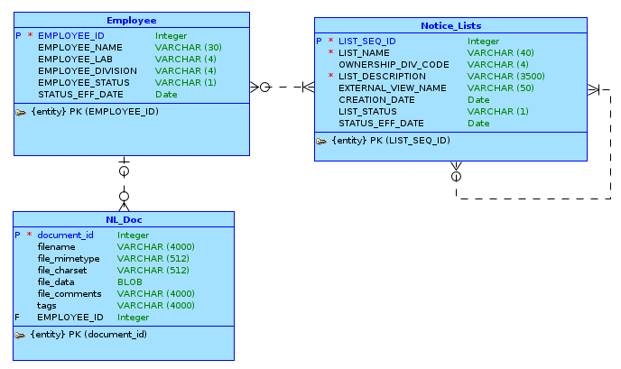
Conceptual Model

Slide 3
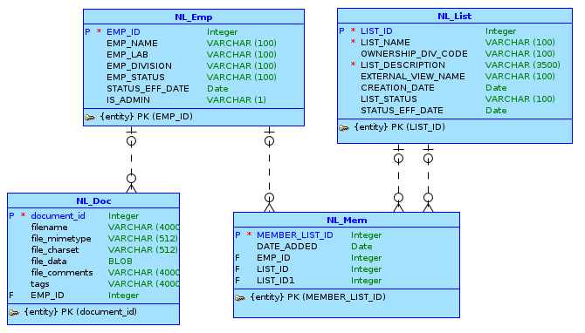
Logical Model

Slide 4
APEX URL
https://apex.oracle.com/pls/apex/f?p=95803:1:965975656901::NO:::
Repository:
https://github.com/xhmf/arl

Slide 5
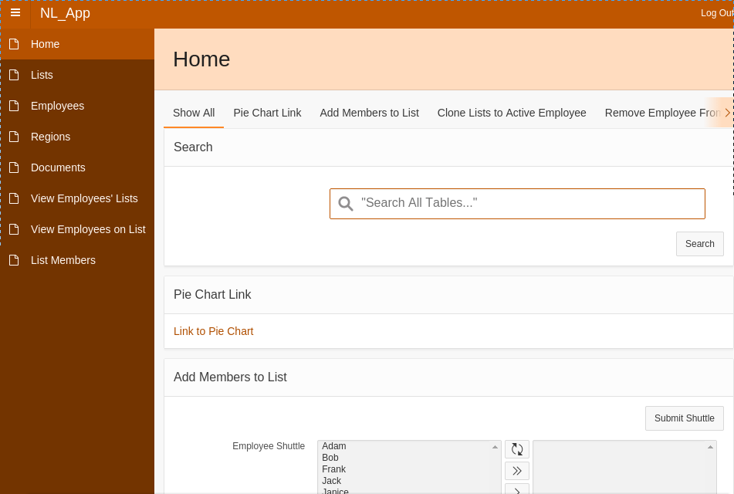
ARL Home Page

Slide 6
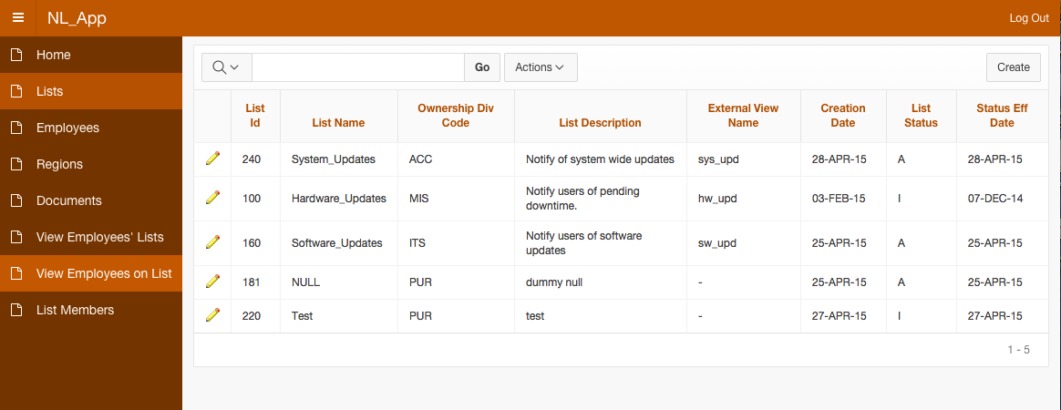
Notification Lists

Slide 7
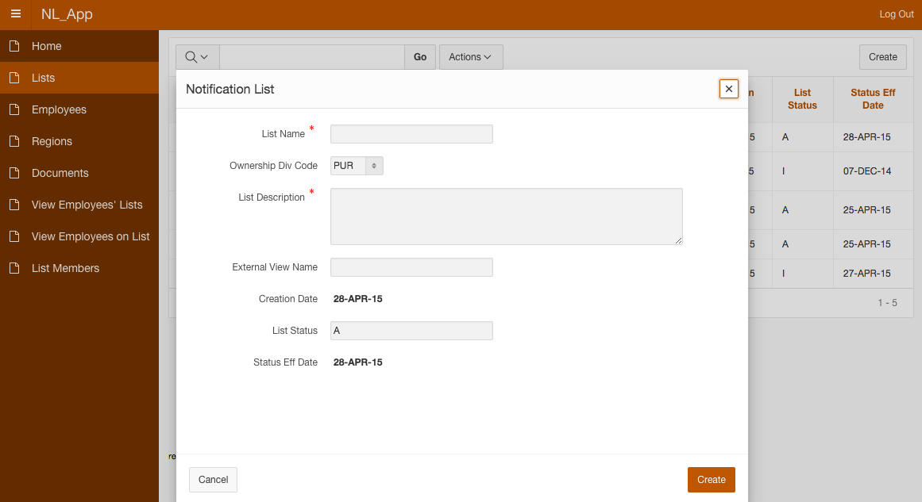

Slide 8
Demo

